Slide 1

Block Cleaning
Pešková Daniela, Beránek Tomáš, Buchta Martin, Klem Richard
Brno University of Technology, Faculty of Information Technology
Božetěchova 1/2, 612 66 Brno - Královo Pole
14.12.2021

Slide 2
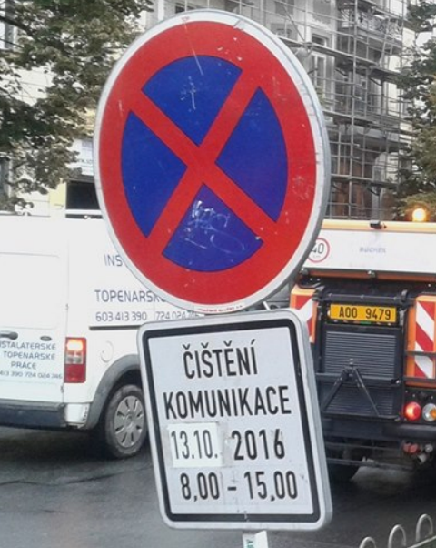
Problem description
Fine for not move away your vehicle.
Fine for a removing a vehicle.
Lack of block cleaning signs.
Not able to check signs.
Block cleaning dates must be searched for each Brno district separately.

Slide 3
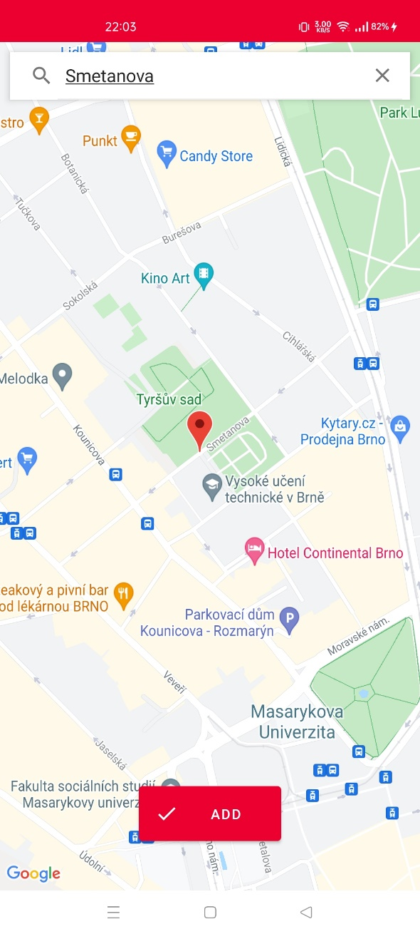
Current state of the application
No need of registartion.
Choose multiple locations from the map.
Places are also supported.
You have a clear information about from which of your locations you need to move away.
You are notified about incoming cleanings.

Slide 4
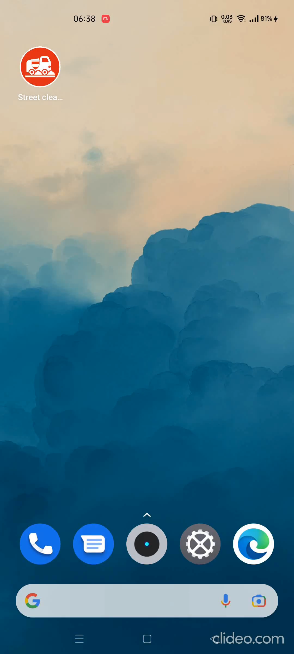
Current state of the application
Install application → Add location → Wait to be notified

Slide 5




Interesting technicals
No server
Material Design icons and UI components.
Multi-language interface based on device system settings.
System notifications
Needs granted permissions.

Slide 6
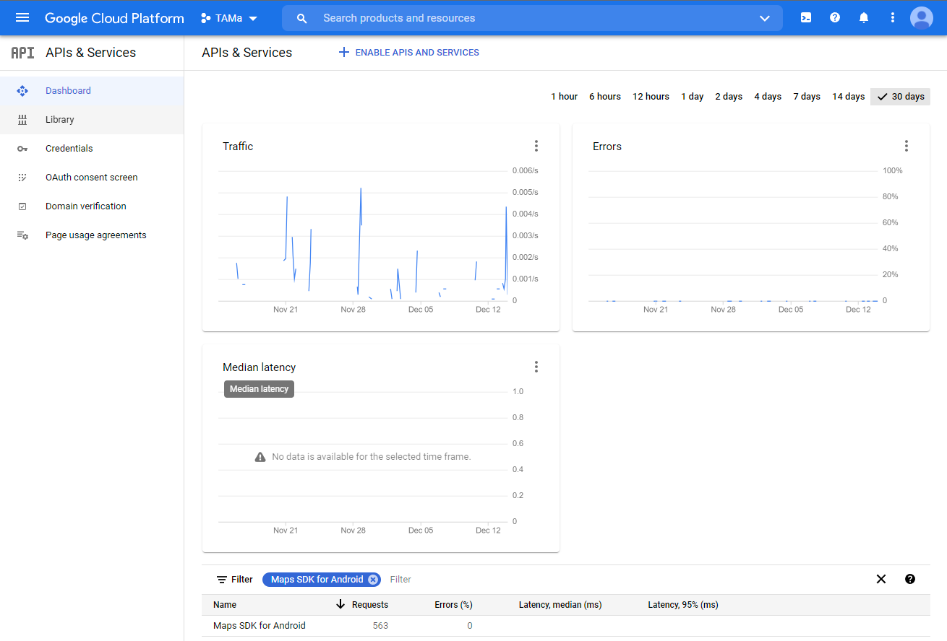
Interesting technicals

Slide 7
Our teamwork experience
Regular communication is essential.
Assertiveness & compromises
Explain a lot.
Push your colleagues gently.
Ownership of both your work and the whole project.
“Better to repeat yourself or information already spoken and looks a bit like a fool instead of misunderstanding and wasting time of everybody.”

Slide 8
Our technical experience
VCS is necessary and works well.
There are available very powerful frameworks and libraries (Jetpack, Volley, KotlinX, …), but often more extensive knowledge is needed.
Development for native Android expects Kotlin knowledge.
Development in Kotlin expects knowledge of Java.
Knowledge of how the Android development should be done is very important.
Learning how to do fundamentals instead of cool stuff.
“You must first exercise with light weights before lifting heavy.“

Slide 9
Unexpected findings
Every application have internet access without asking a user.
Creating an app for a mobile device is much more than just writing some of code.
UI, animations, intuitiveness, control, easy of use, etc.
Very different work compared to the other school projects.
Thinking, communication, …
How to make B+ tree algorithms vs. How to satisfy a user.

Slide 10
Lessons learned
It is not that easy and straightforward as it looks at the beginning.
Longer path to the goal is not necessarily worse.
Work in team comes with some overhead but if managed effectively, then the overall work is faster and of better quality.
With new, more experience, you can go further next time.
“Documentation reading is like a roulette. If it is written well, you win. If it is not so good, you’ve just killed your time.”

Slide 11
Thank You For Your Attention!

